Slide 1
Slaviša Đurđić
Eurovision
Goal: Analysis of the Tableau “Eurovision 1998 to 2010” entertainment sample dataset for period 1998-2012.
Instructions:
- Collect data by downloading the Excel file from https://public.tableau.com/app/learn/sample-data?qt-overview_resources=1#qt-overview_resources.
- Use SQL queries to load the data to MySQL table(s).
- Execute some basic SQL queries.
- Build visuals in Tableau (https://public.tableau.com/app/profile/slavisadurdic/viz/EurovisionSampleDataset/StoriesofEurovision).
- Run regression analysis in Python.
Belgrade, September 2023

Slide 2
MySQL queries
USE data_analysis;
CREATE TABLE eurovision (
id INT, year VARCHAR(255),
country VARCHAR(255), region VARCHAR(255),
artist VARCHAR(255), song VARCHAR(255),
artist_gender VARCHAR(255), group_solo VARCHAR(255),
place INT, points INT,
home_away_country VARCHAR(255), home_away_region VARCHAR(255),
is_final BOOLEAN, semi_final_number VARCHAR(255),
song_in_english BOOLEAN, song_quality VARCHAR(255),
normalized_points VARCHAR(255), energy VARCHAR(255),
duration VARCHAR(255), acousticness VARCHAR(255),
danceability VARCHAR(255), tempo VARCHAR(255),
speechiness VARCHAR(255), key_field VARCHAR(255),
liveness VARCHAR(255), time_signature VARCHAR(255),
mode_field VARCHAR(255), loudness VARCHAR(255),
valence VARCHAR(255), happiness VARCHAR(255)
);
LOAD DATA INFILE ‘eurovision.csv’
INTO TABLE eurovision
FIELDS TERMINATED BY ',’
LINES TERMINATED BY '\n’
IGNORE 1 ROWS;

Slide 3
MySQL queries
WITH cte AS (
SELECT id,year,country,region,artist,song,artist_gender,group_solo,place,points,home_away_country,home_away_region,is_final,semi_final_number,song_in_english,song_quality,normalized_points,energy,duration,acousticness,danceability,tempo,speechiness,key_field,liveness,time_signature,mode_field,loudness,valence,happiness,
ROW_NUMBER() OVER(PARTITION BY id,year,country,region,artist,song,artist_gender,group_solo,place,points,home_away_country,home_away_region,is_final,semi_final_number,song_in_english,song_quality,normalized_points,energy,duration,acousticness,danceability,tempo,speechiness,key_field,liveness,time_signature,mode_field,loudness,valence,happiness) AS RN
FROM data_analysis.eurovision
)
SELECT * FROM cte WHERE RN > 1;

Slide 4
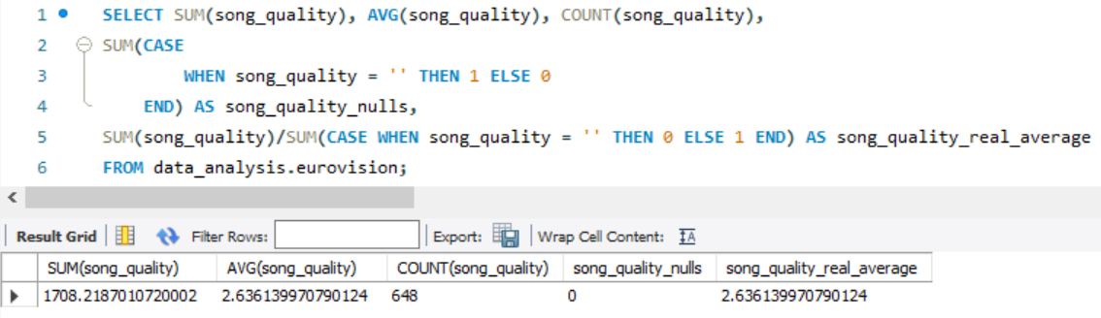
MySQL queries
Average quality of all songs for the period 1998-2012 was 2.64.

Slide 5
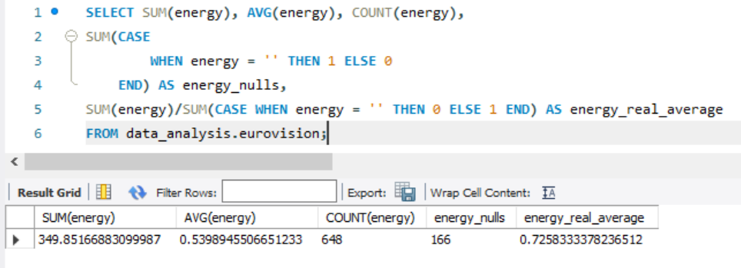
MySQL queries
NULLS, i.e., missing data has been inserted into the table as empty strings (‘’). Let's take for example the column 'energy' - there are 166 fields with no data.

Slide 6
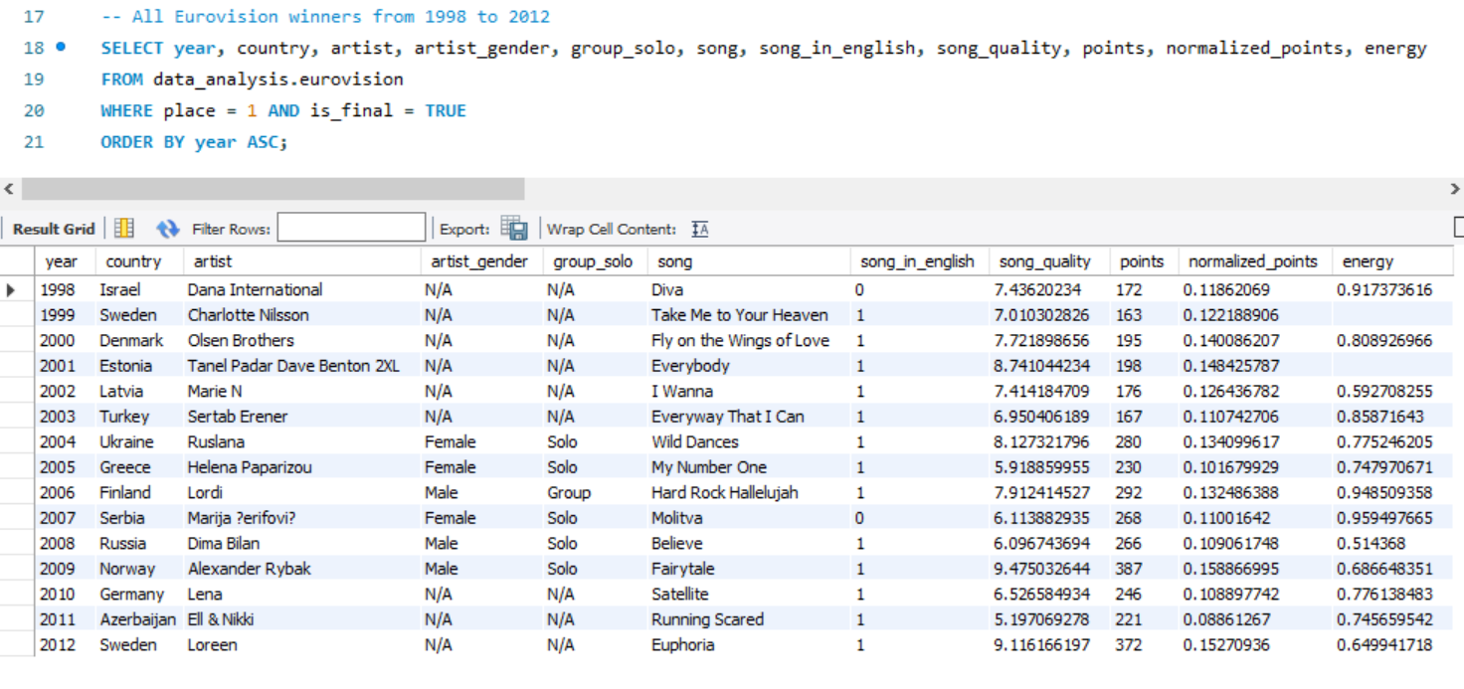
MySQL queries

Slide 7
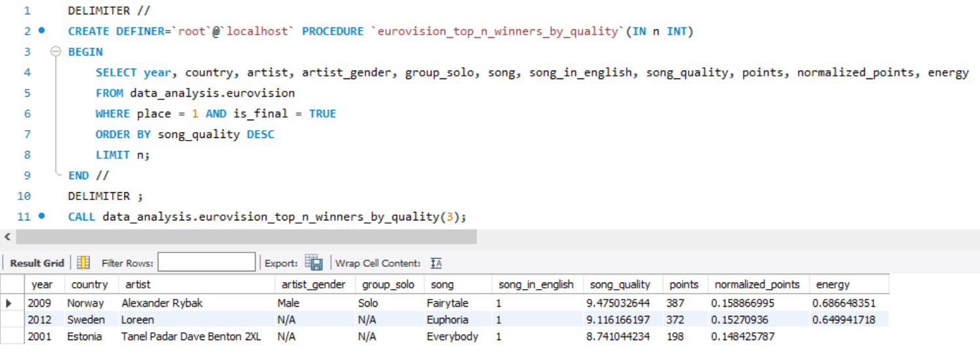
MySQL queries
Return N-number of Eurovision song winners rated by song quality (given that there are 15 winners in total, at the same time it is the maximum number of row results that query can provide, even if the input value is higher than 15):

Slide 8

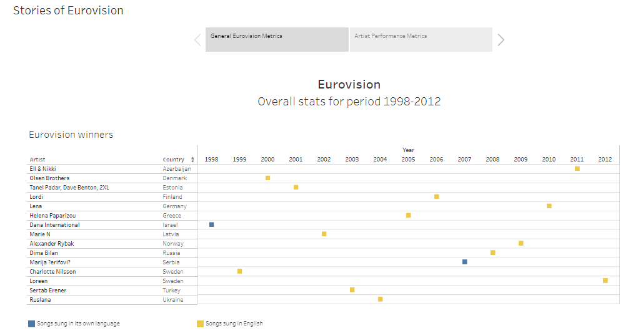

Slide 9
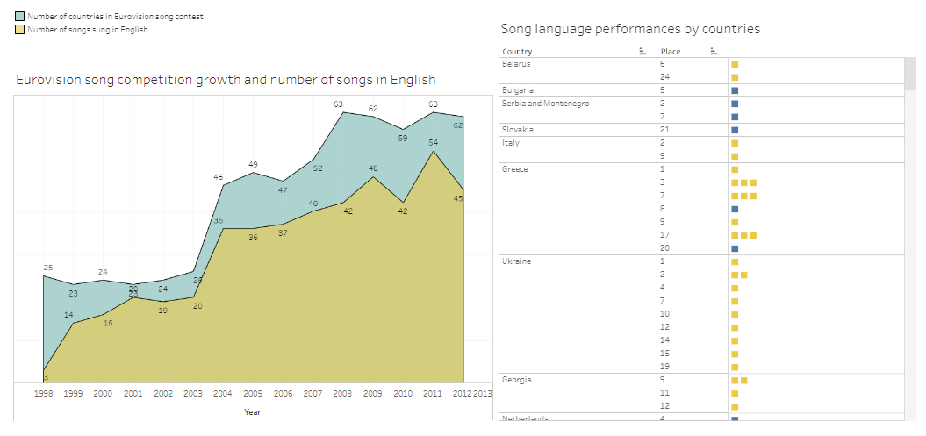

Slide 10
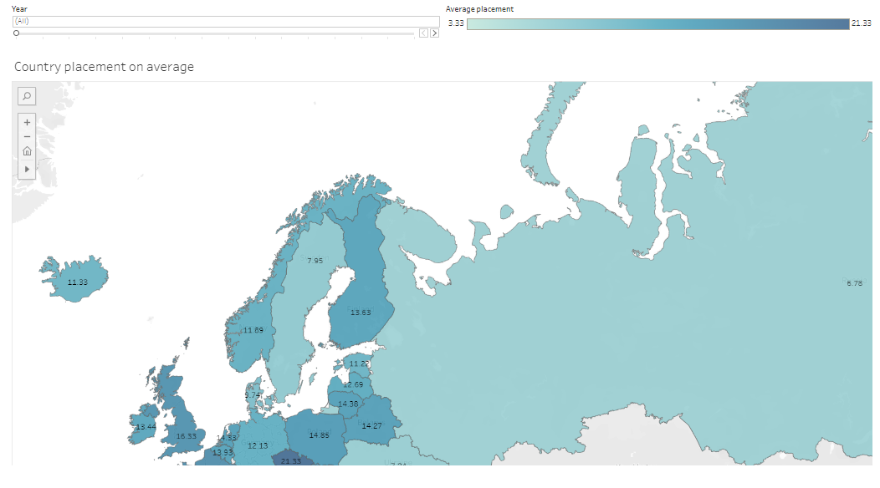

Slide 11
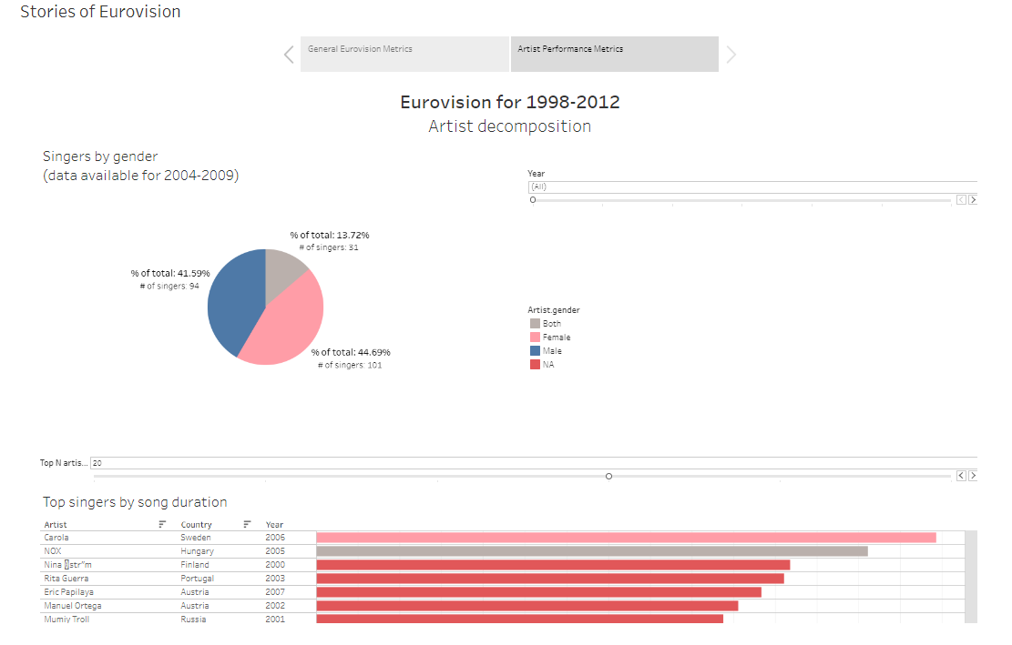

Slide 12
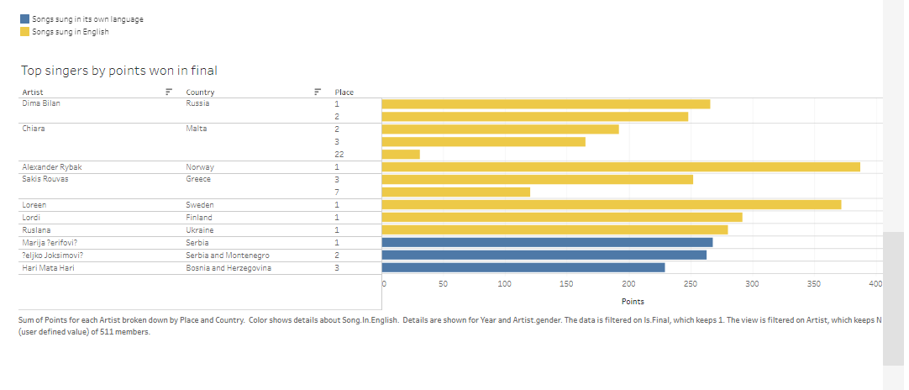

Slide 13
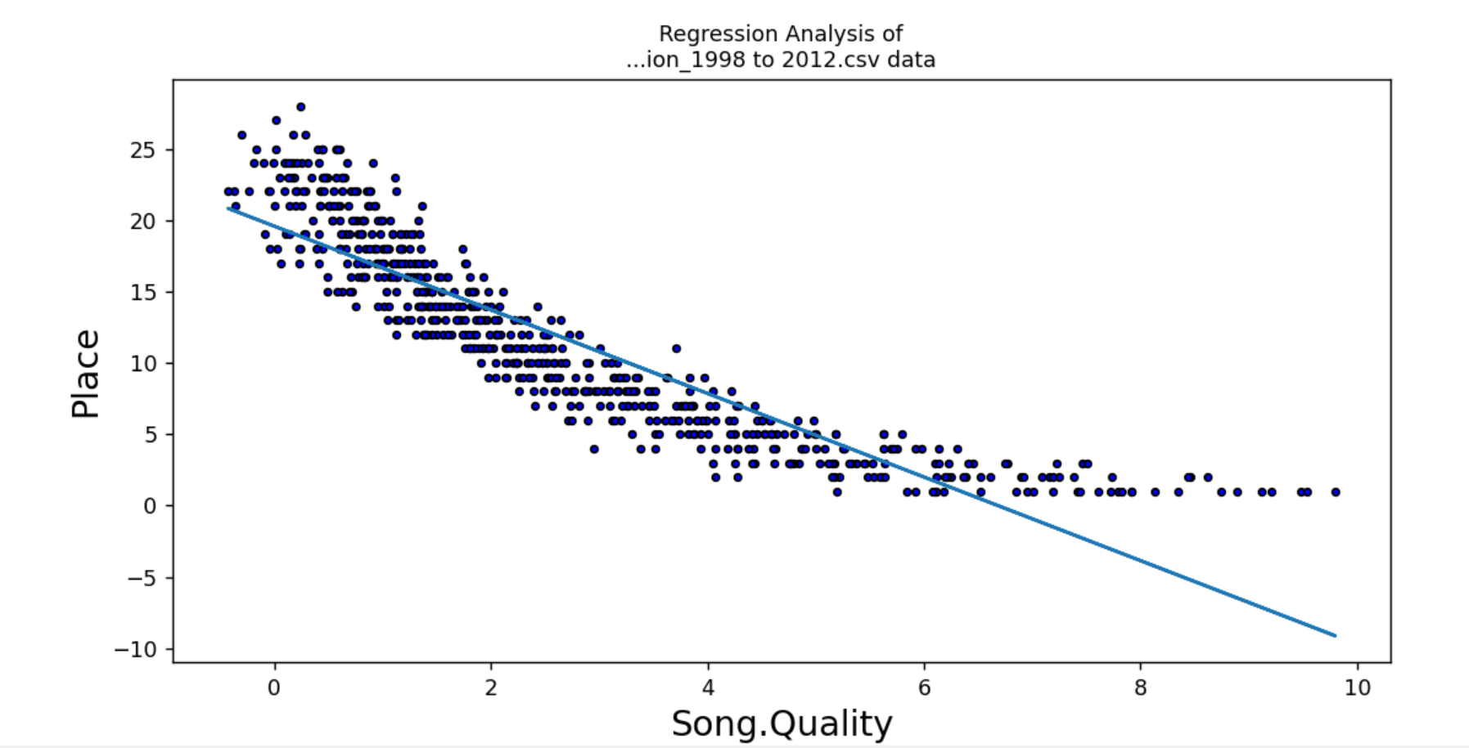
Regression Analysis in Python
R is -0.901079563161771 R^2 is 0.8119443791478079

Slide 14
Superstore Project Insights
1) Sweden appears to be the only country that managed to repeat the success during the analyzed period - Sweden took first place in year 1999 and 2012.
2) Generally, Eurovision songs have been sung in English - btw. there are only two winning songs sung in their native language (Israel: year 1999, and Serbia: year 2007).
3) Interestingly, Azerbaijan, Italy, and Serbia turned out to be the best performing countries in term of the average placement.
4) Song quality from Echonest, together with many other metrics, remained stable during the observed period.
5) Singers are more or less equally distributed by gender, as well as finalists by stage energy and danceability.

